Slide 1
Introducing…

Slide 2
The Most Protective Support Surface Ever Developed
Designed and developed in lab testing to provide the highest level of ulcer prevention performance
Created to be superior to every other foam mattress in providing:
Pressure redistribution
Unsurpassed envelopment
Friction and shear reduction
Temperature and moisture management
Unmatched comfort

Slide 3
Envelopment Chart
 | Envelopment (Area in²) | Performance Difference vs. Bodyzone (%)
Standard Mattresses
Mattress I | 605 | 24
Mattress II | 611 | 23
Mattress III | 608 | 24
Mattress IV | 541 | 32
Mattress V | 695 | 13
Mattress VI | 697 | 13
Mattress VII | 658 | 17
Mattress VIII | 647 | 19
Mattress IX | 642 | 19
Mattress X | 604 | 24
BodyZone Mattress | 798 | NA
Bariatric Mattresses
Mattress XI | 521 | 20
Mattress XII | 552 | 15
BodyZone Mattress | 652 | NA
*This Chart shows the “TOP Ten” Medical Mattresses in the US compared to our BodyZone design.

Slide 4
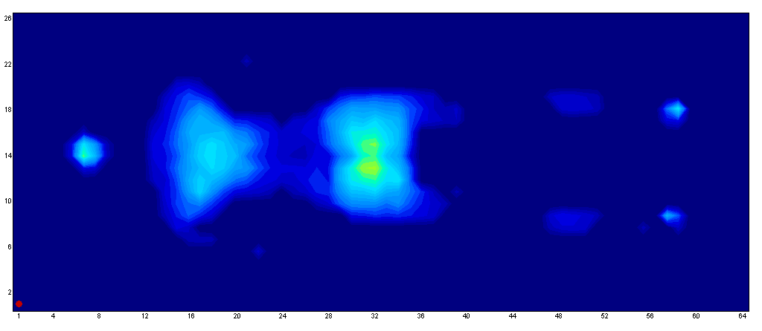
Bodyzone 300
Female subject
Height = 5’ 3”
Weight = 120 lbs.
Average pressure = 14.98
Maximum pressure = 40.20
Head pressure = 33.93
Sacrum pressure = 36.22
Heel pressure = 28.92

Slide 5
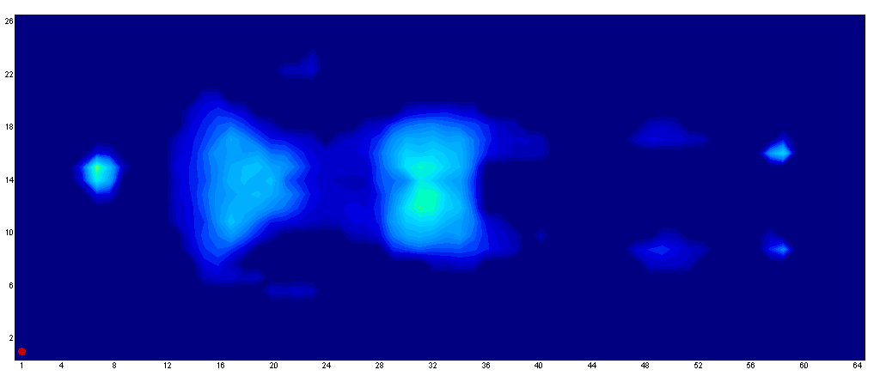
Bodyzone 500
Female subject
Height = 5’ 3”
Weight = 120 lbs.
Average pressure = 14.58
Maximum pressure = 38.84
Head pressure = 35.81
Sacrum pressure = 32.71
Heel pressure = 28.33

Slide 6
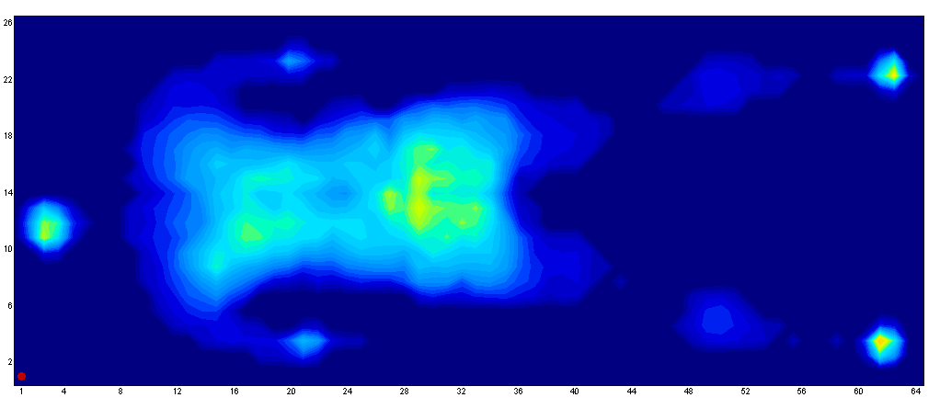
Bodyzone 300
Male subject
Height = 6’ 3”
Weight = 250 lbs.
Average pressure = 14.98
Maximum pressure = 40.20
Head pressure = 40.26
Sacrum pressure = 40.37
Heel pressure = 42.82

Slide 7
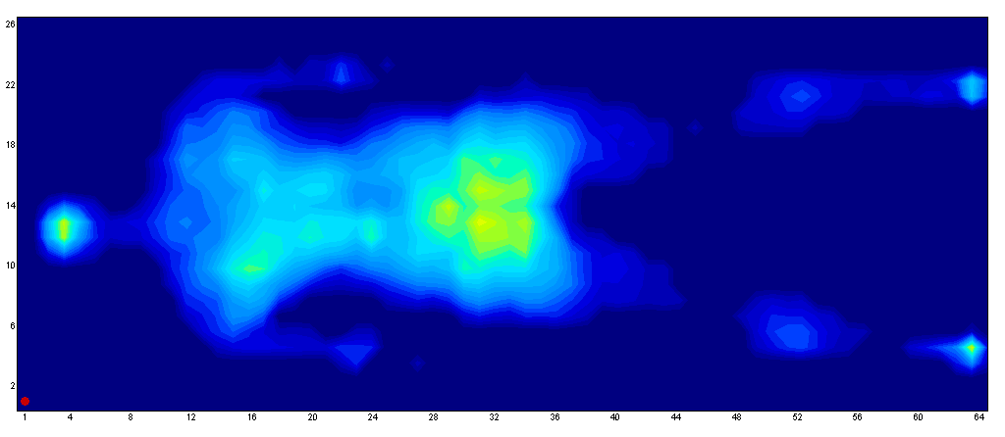
Bodyzone 500
Male subject
Height = 6’ 3”
Weight = 250 lbs.
Average pressure = 14.58
Maximum pressure = 38.84
Head pressure = 25.71
Sacrum pressure = 40.83
Heel pressure = 37.45

Slide 8
“Pressure mapping tests of the standard and bariatric mattresses clearly show the advantages of the Bodyzone surface, with substantially lower values for average and maximum pressure. In the clinical situation this should translate to significant advantages for the prevention and treatment of pressure ulcers, by reducing the main threat to patients, pressure.”
This is from the conclusion of our Accepted SAWC Abstract

Slide 9
In Conclusion:
New BodyZoneTM offer you true product differentiation through:
The highest innovation
Proven superior performance
Demonstrated product durability
Extensive manufacturing and delivery capabilities
Commitment to green products and processes
Investment in technology and expertise
Value that goes beyond pricing

